Slide 1
Surface registration
SlicerIGT Tutorial Series

Slide 2
Registration methods overview
Dimension
3D/2D to 3D/2D
Metric
Point distance-based
Surface distance-based
Image similarity-based
Transformation
Rigid
Similarity
Deformable
this example

Slide 3
Surface registration
Finds transformation that minimizes points cumulative distance from a surface
Y
Y
Initial
X
Z
Ras
X
Z
InitialToRas

Slide 4
Registration strategy
Y
Y
Y
X
Reference
Z
Initial
X
ReferenceToInitial
Z
Ras
X
Z
InitialToRas
Fiducial Registration
3 points in Reference
3 points in Initial
approximate locations
Fiducial-Model Registration
~30-40 points in Initial
CT-based surface model in RAS

Slide 5
Result transform type
Rigid
Translation + Rotation
Commonly used, because objects don't change size
Similarity
Translation + Rotation + Scaling
Used when changing units, e.g. pixels to millimeters
Warping
Splines, etc.
Used to model soft tissue deformations

Slide 6
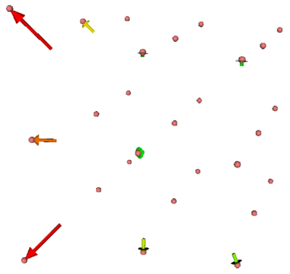
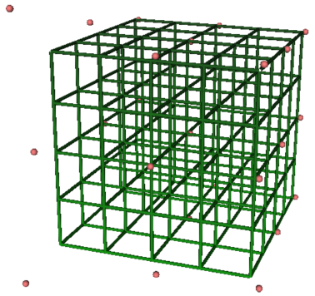
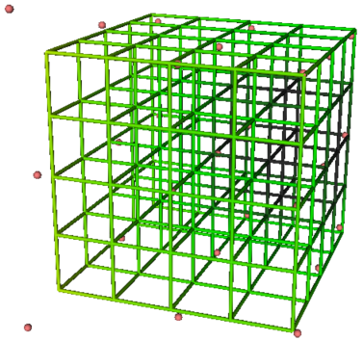
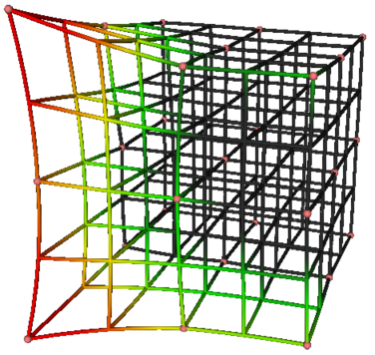
Fiducial displacement:
Rigid
Similarity
Warping
RMSE = 4.8
RMSE = 4.2
RMSE = 0.0

Slide 7
Load example scene
Load three pieces of data in a clean Slicer scene:
SlicerIGT-Data\Skull_Registrations.mrb contains stylus position and video sequences
SlicerIGT-Data\Skull_Phantom.vtk contains a detailed surface model of the skull
SlicerIGT-Data\Skull_StylusTipToStylus.h5 contains pivot calibration for the stylus
You can drag-and-drop all these files on Slicer and load them with default options
Create a needle model using IGT / CreateModels

Slide 8

Set up transform hierarchy
Select Data module
Right-click on Scene and insert new transform, and double-click on it to rename to InitialToRas
Right-click on InitialToRas and insert transform, and double-click to rename it to ReferenceToInitial
Drag and Drop nodes to get the following transform hierarchy

Slide 9
Stylus coordinate systems
There are two coordinate systems associated with a stylus tool:
Stylus
Origin: center of the position marker
StylusTip
Origin: tip of the stylus.
The StylusTipToStylus transformation is computed using the Pivot Calibration algorithm.
Y
Stylus
Y
X
Z
StylusTipToStylus
StylusTip
X
Z
: position marker

Slide 10
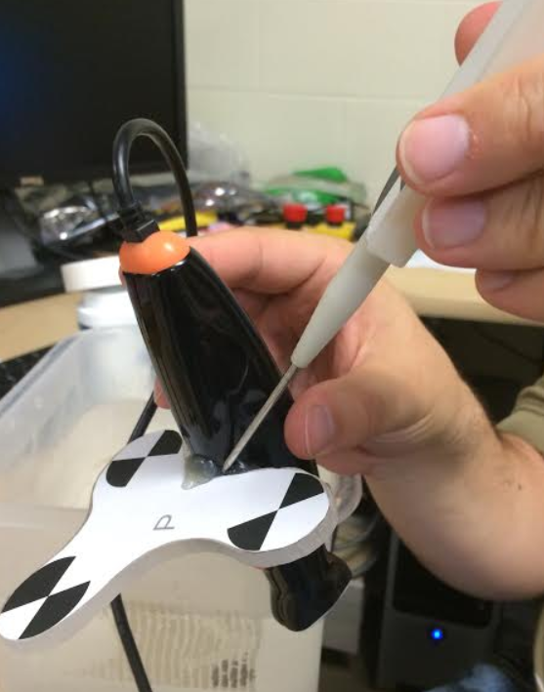
Pivot Calibration in a Real Hardware Setup
When performing a pivot calibration with a tracked needle
Find a secure position to pivot in the Reference coordinate system
You must not shift the tip of the needle, only the shaft of the needle may move relative to the tip while you pivot

Slide 11
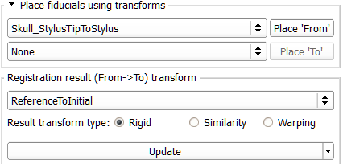
Set up initial registration
Select IGT / Fiducial Registration Wizard module
Create From fiducials as ReferencePoints, and To fiducials as InitialPoints
Under Place fiducials... group select Skull_StylusTipToStylus for the From (upper) list
Under Registration result select ReferenceToInitial, and set Manual update instead of Auto-update

Slide 12


How Place fiducials... work
Y
Y
Stylus
StylusToReference
Y
StylusTip
X
Z
X
Reference
Z
StylusTipToStylus
X
Z
adds this point in this coordinate system to this list
because of this selection and this transform hierarchy

Slide 13

Initial registration
In the Sequence toolbar, select InitialLandmarks
Using the Sequence toolbar time slider, review video for landmarks
Use the place fiducials button to add these points (in the same order!) in the InitialPoints list
Use Place 'From' button to add points to the ReferencePoints list
Do this three times, so you have three points in both lists
Watch next slide for illustration

Slide 14
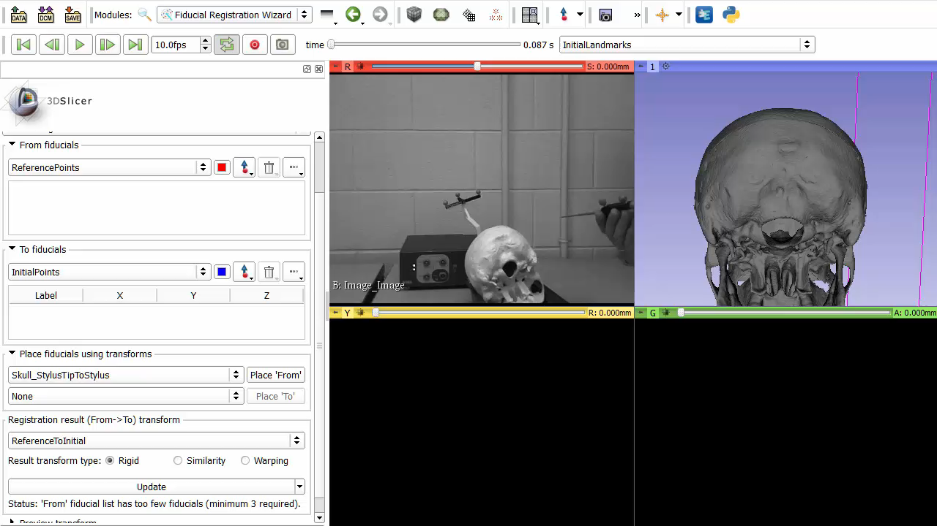
Initial registration

Slide 15
Compute initial registration
Under Registration result press Update
If you don't see "Status: Success!" under the Update button, check if you have three different points in both lists.
RMS Error should be under 10 mm ideally, but not necessarily
Note: that if you want to restart initial registration, you need to go to Transforms module and press Identity on ReferenceToInitial transform to reset it. Otherwise, StylusTip will not be in Reference.

Slide 16
Collect surface points
Still in the Fiducial Registration Wizard module, create a new list under From fiducials and name it InitialSurfacePoints
On Sequence toolbar, select the SurfaceScan node
Let the sequence run using the play button, maybe lower frame rate to 5 fps
Keep clicking Place 'From' until you collect about 40 points evenly near the skull surface
Screen video on next slide

Slide 17
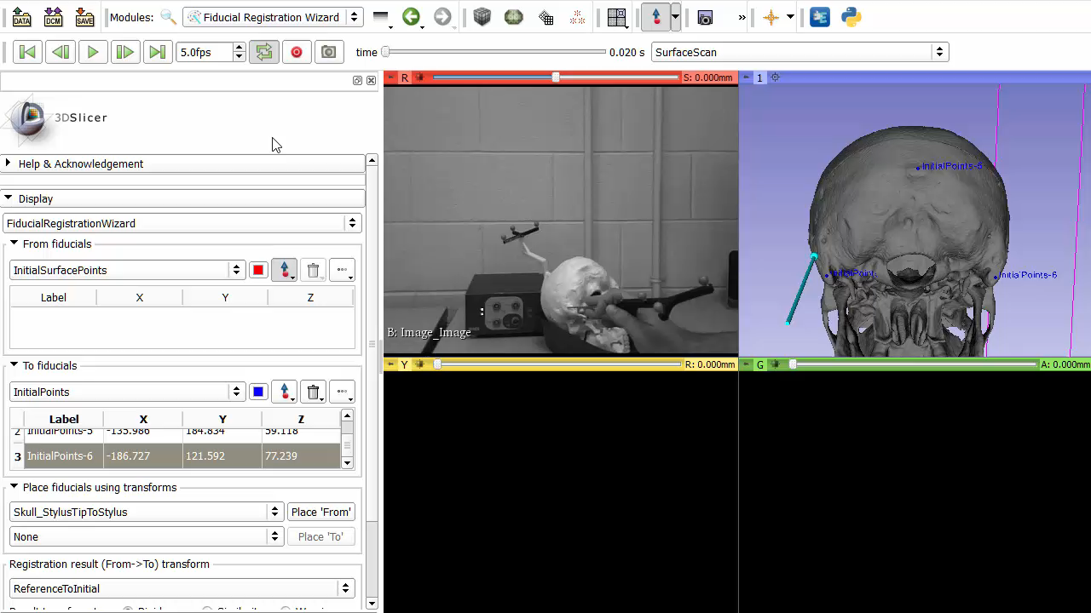
Collect surface points

Slide 18
Compute surface registration
Select IGT / Fiducial-Model Registration module
Input fiducials: InitialSurfacePoints
Input model: Skull_Phantom
Output transform: InitialToRas
Press Apply
Mean distance after registration should be under 1 mm
When you play the SurfaceScan sequence, the stylus tip should be sliding on the skull surface in the 3D viewer

